Slide 1
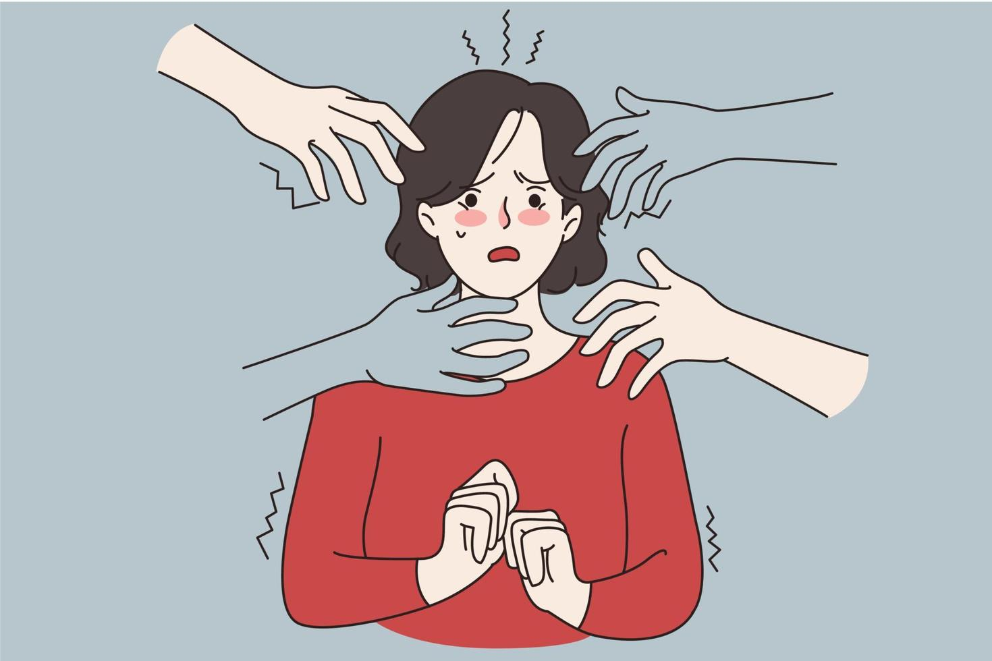
Panic Attack
& Panic Disorder
Data Analysis ( Overview & Insights )
Panic attacks are sudden, intense feelings of fear that cause physical symptoms like a racing heart, fast breathing and sweating.
Some people who experience panic attacks develop panic disorder, a type of anxiety disorder.
Therapy and medications can treat panic attacks and panic disorder.

Slide 2
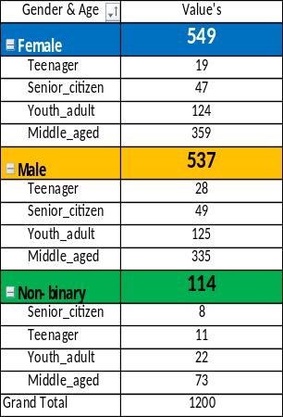
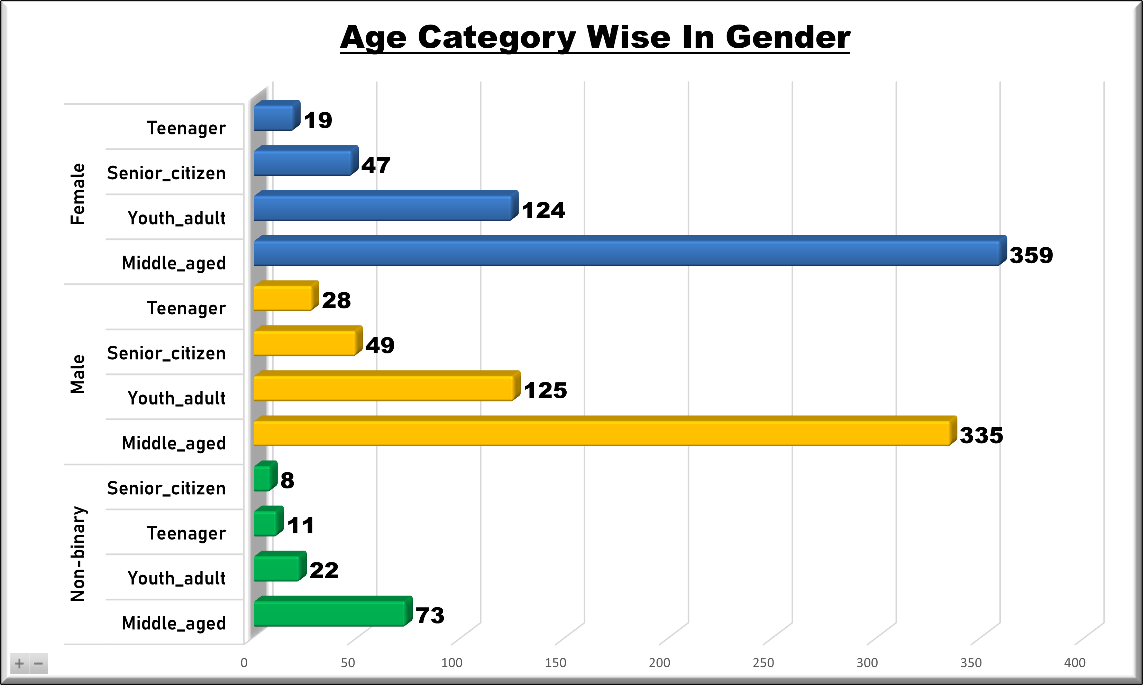

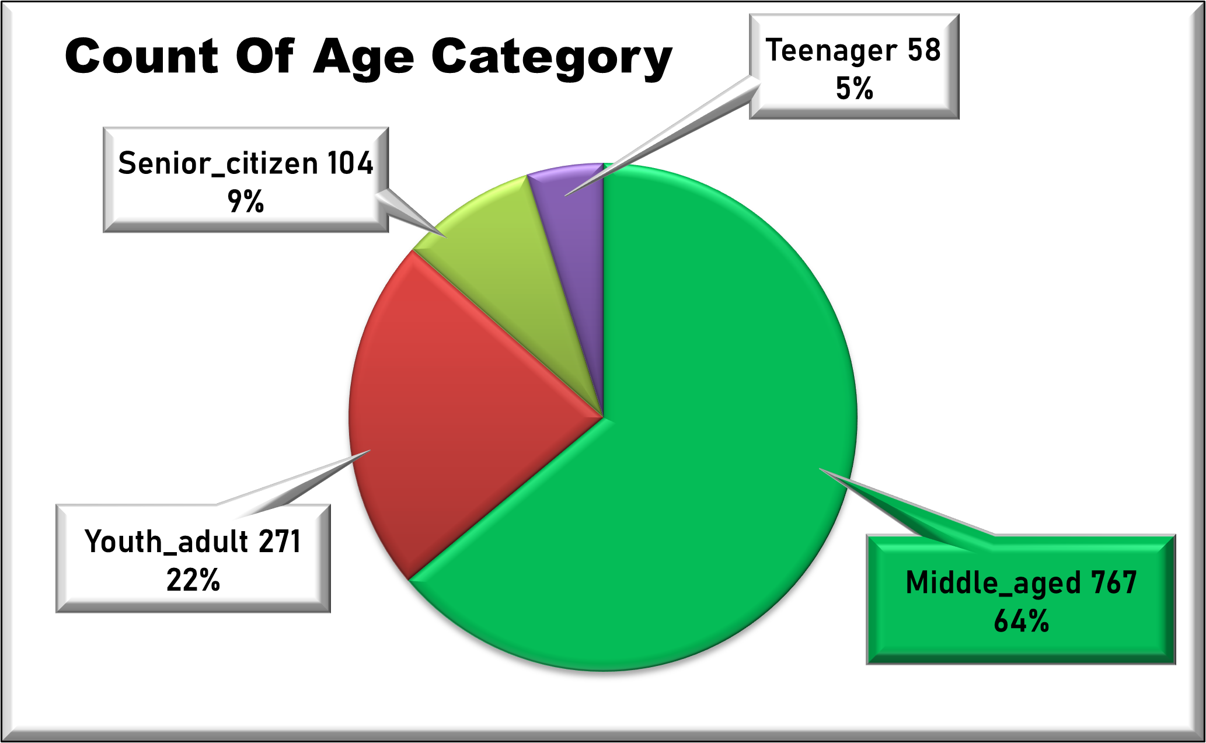
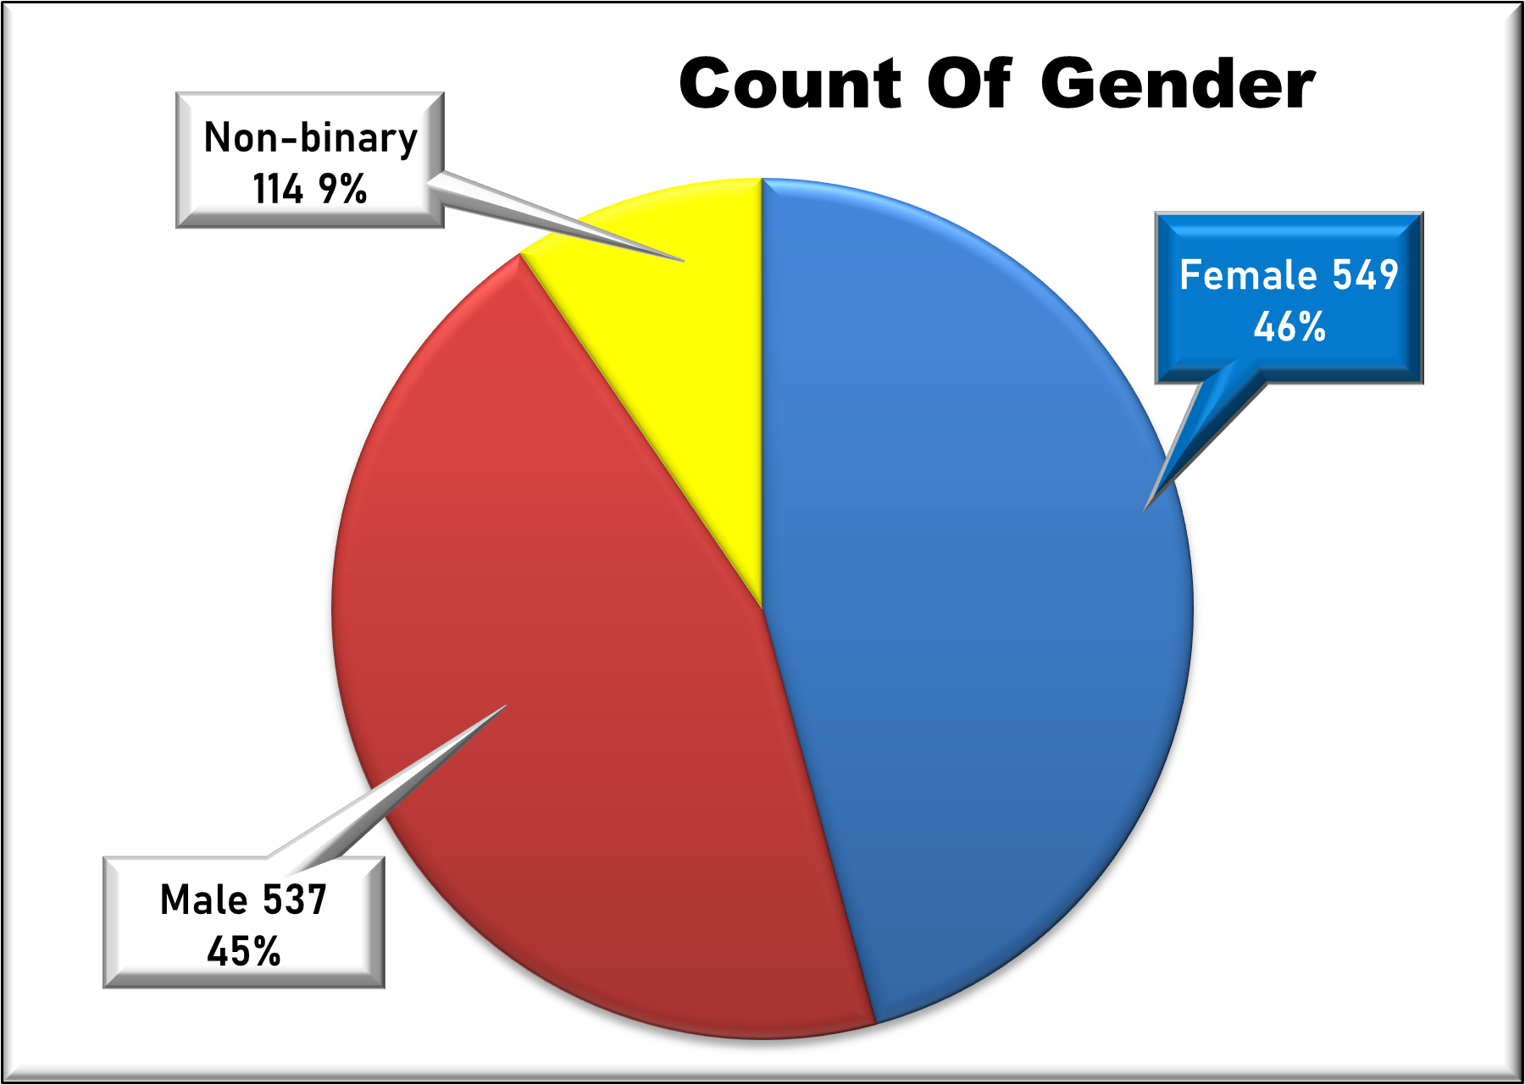
Gender & Age Group Distribution
In this given 1200 records of Panic Attack data set. With in the Middle Aged Peoples are lead on the top in Age Category Column Which is 767 ( 64 % ).
In this given 1200 records of Panic Attack data set. With in the female`s are lead on the top in Gender Column .Which is 549 ( 46 % ).

Slide 3
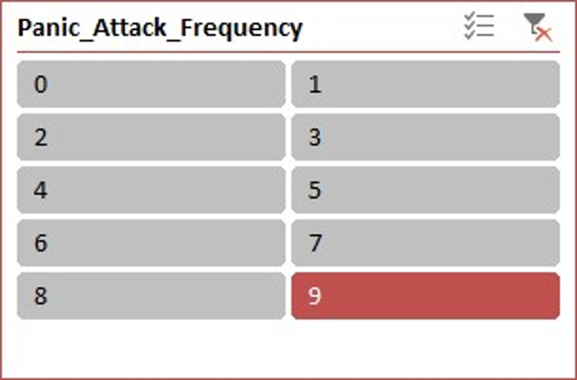
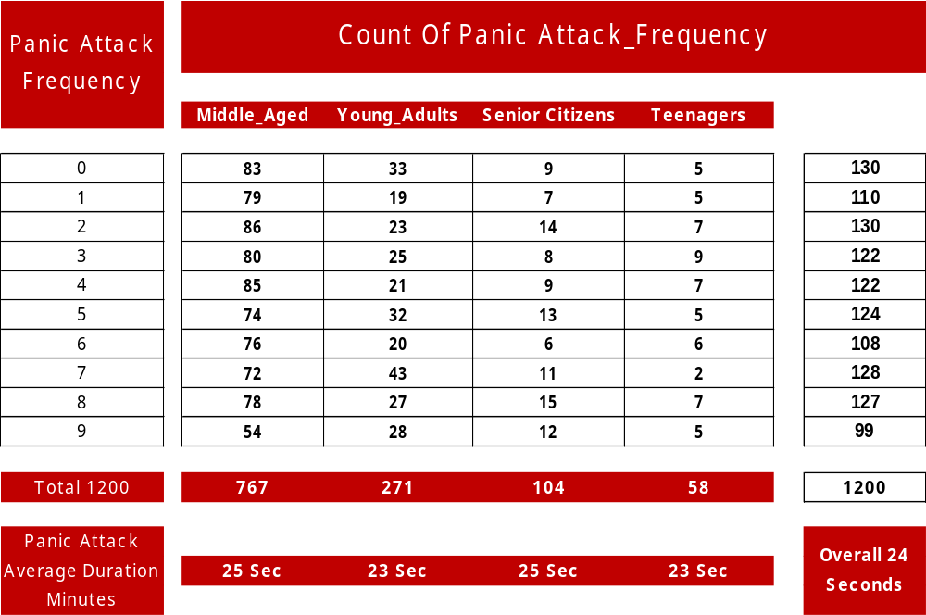
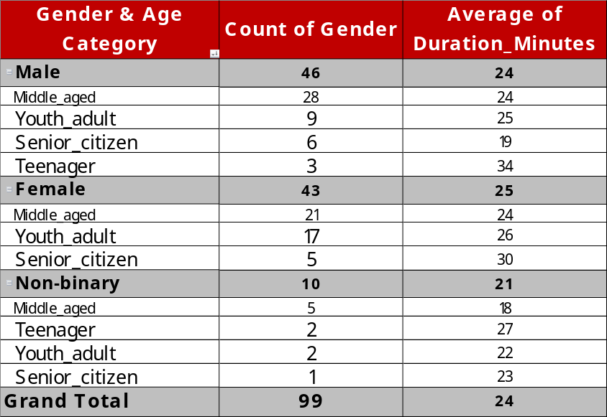

Panic Attack Frequency & With Duration
Slicer >>
$$→$$
Male participants represent the largest group with 46 individuals.
These observations point to a diverse sample in terms of Gender & Age , with relatively similar average panic attack durations across groups except for some variances among subcategories.
The total count of all genders is 99. The overall average duration of panic attacks in 24 minutes.
These trends indicate that Middle Aged - Adults are the most affected demographic for panic attacks in this sample and average duration is less than half a minute across all groups.

Slide 4
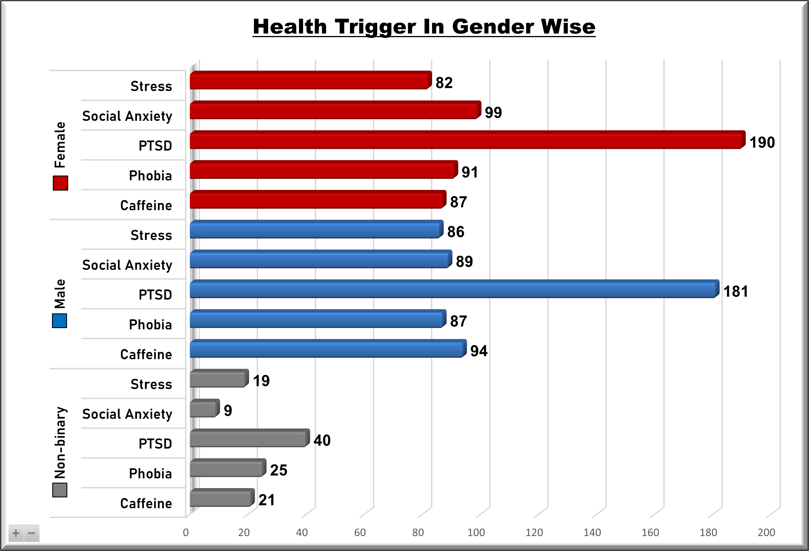
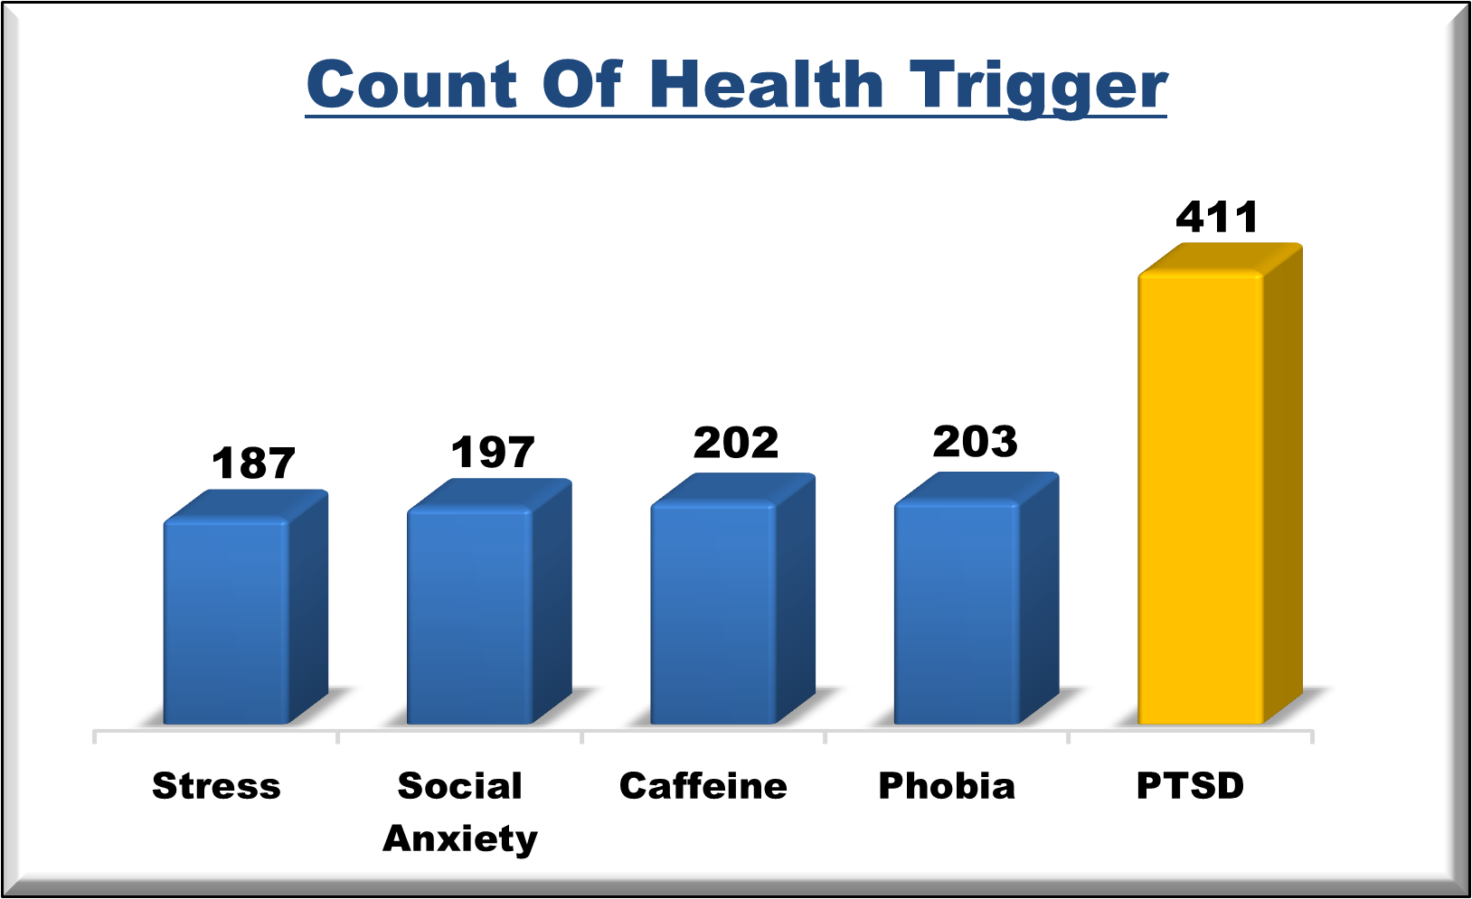
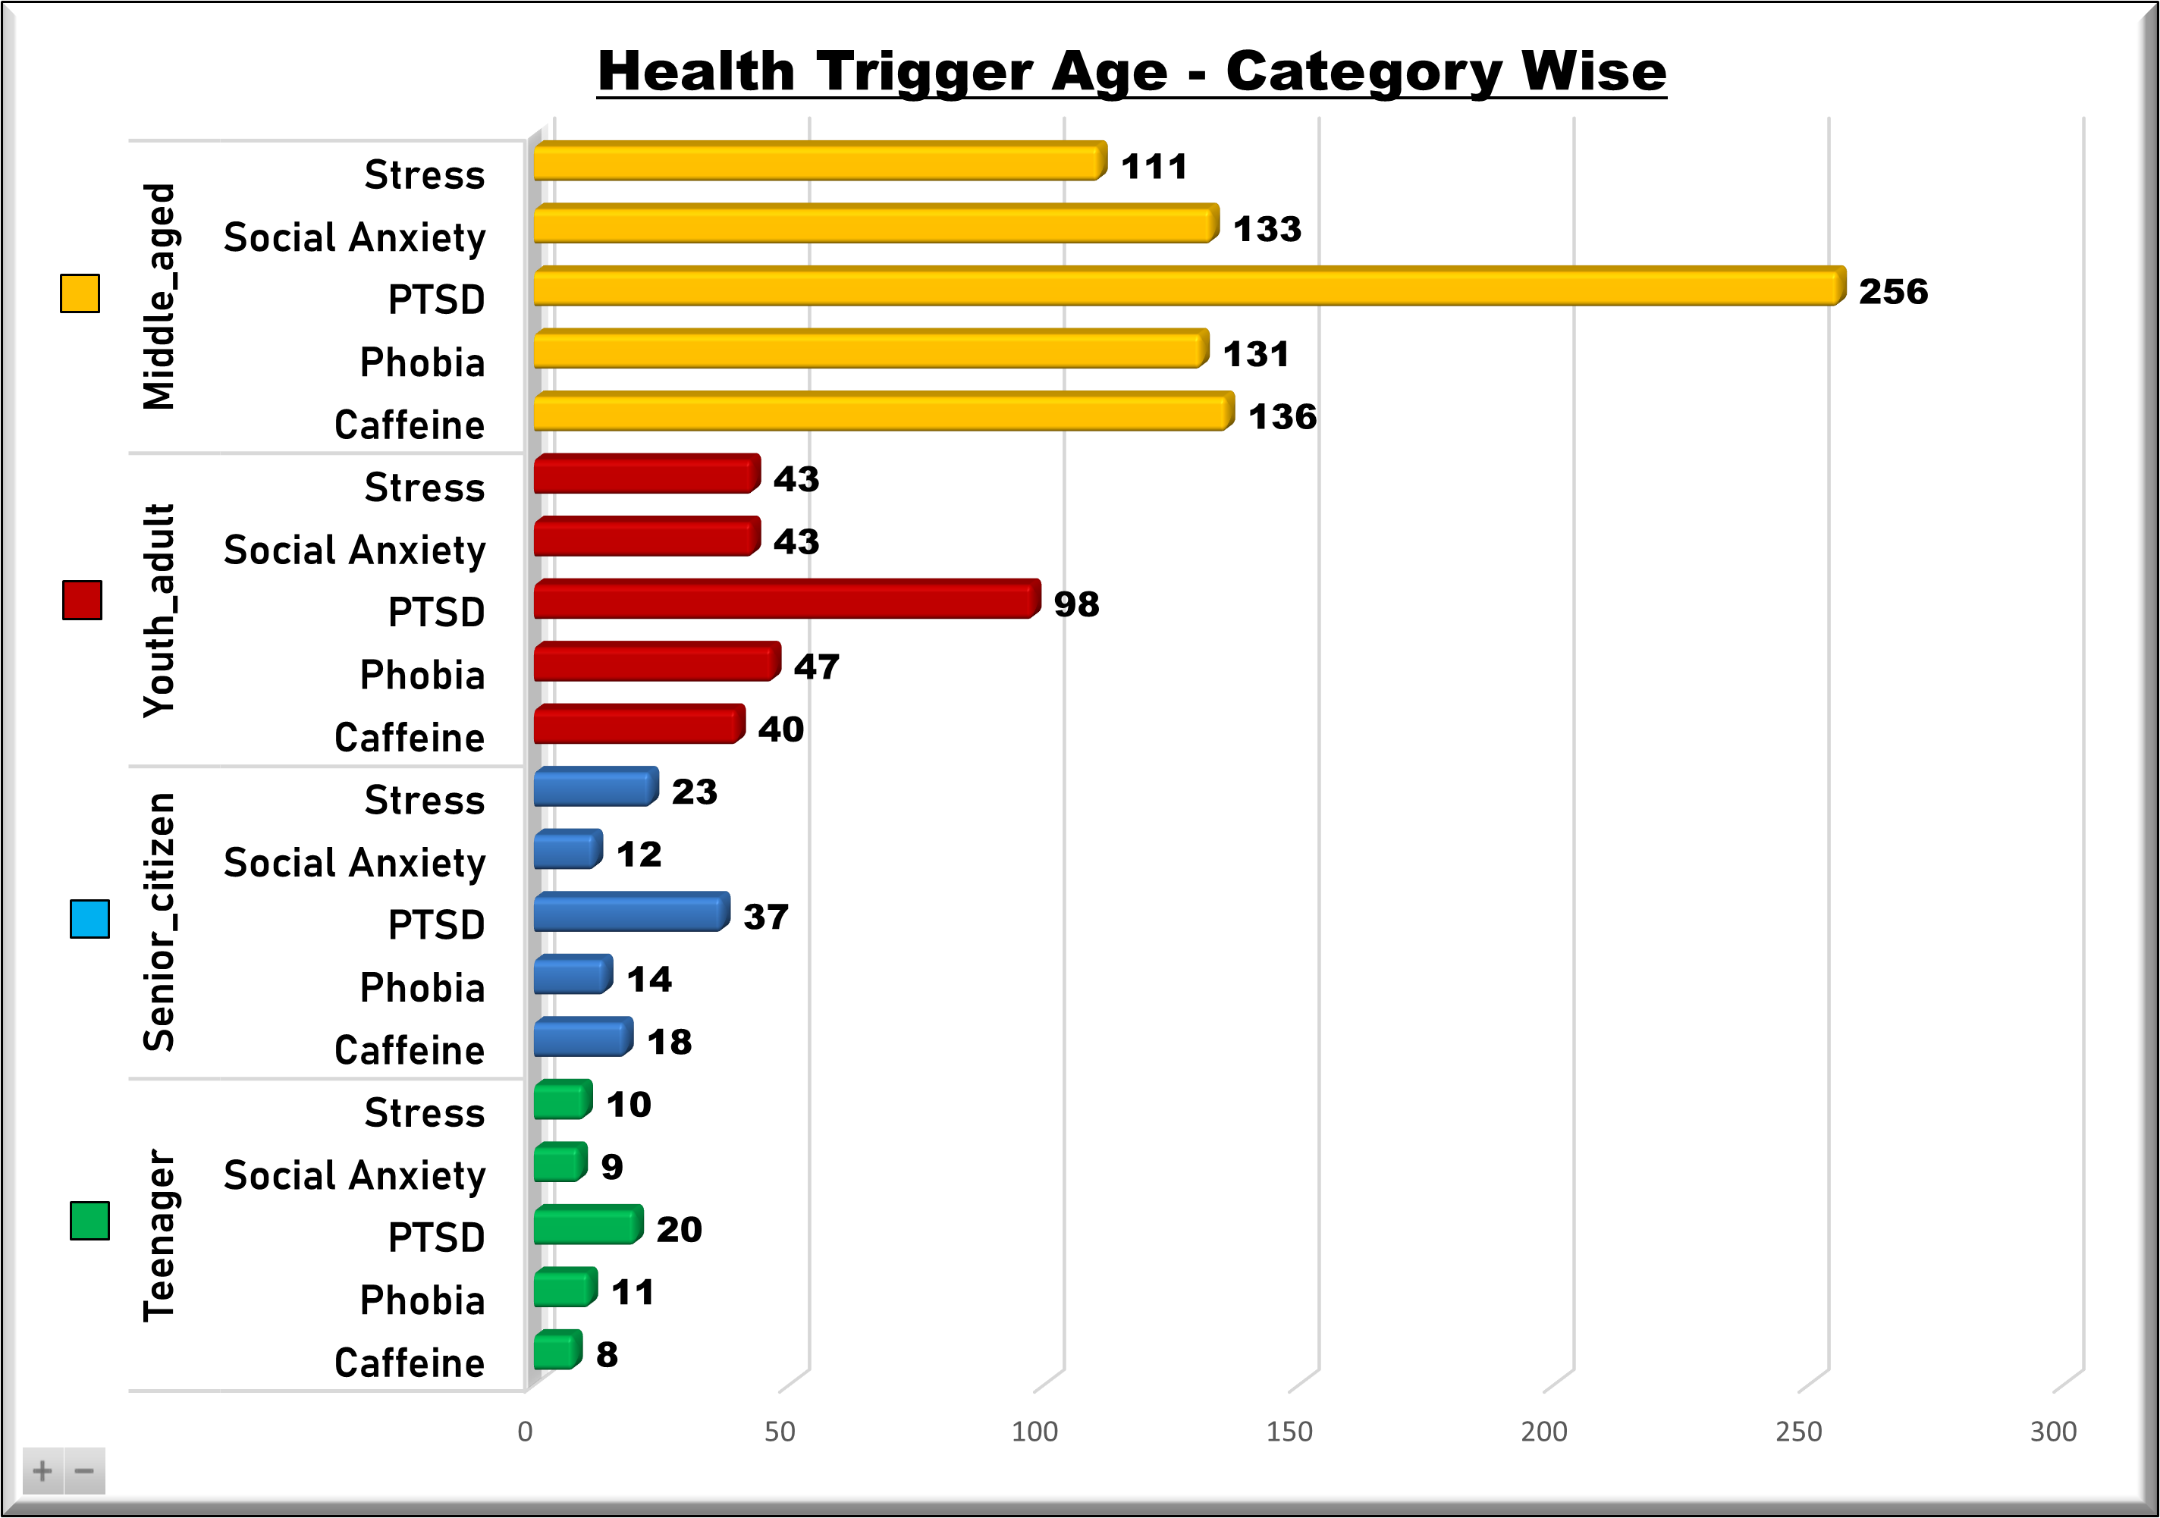
Gender & Age Category Wise
Panic Attacks (Trigger) Distribution
In this above count plot , most people have PTSD - Post-Traumatic Stress Disorder 411 patients , ( 34 % ).
In this second bar plot , most of GENDERS “ Male’s - 537 patients & Female’s – 549 patients ,, have some disease’s also mental health problems.
In this third bar plot ( Slide 10 ) ,most of AGE GROUPS Middle Aged ( 34-60 ) , 767 patients have some disease’s also mental health problems. In the least of Teenager’s ( 13-19 ), 58 patients are there.

Slide 5
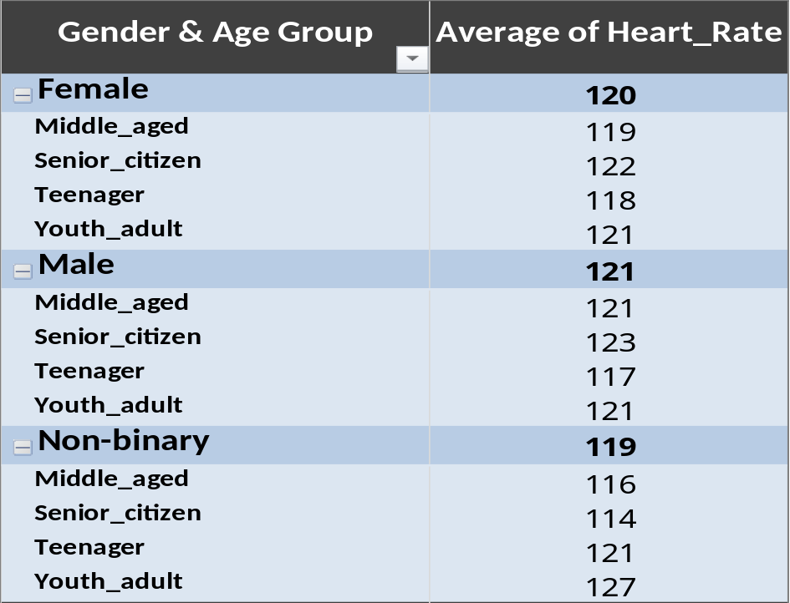
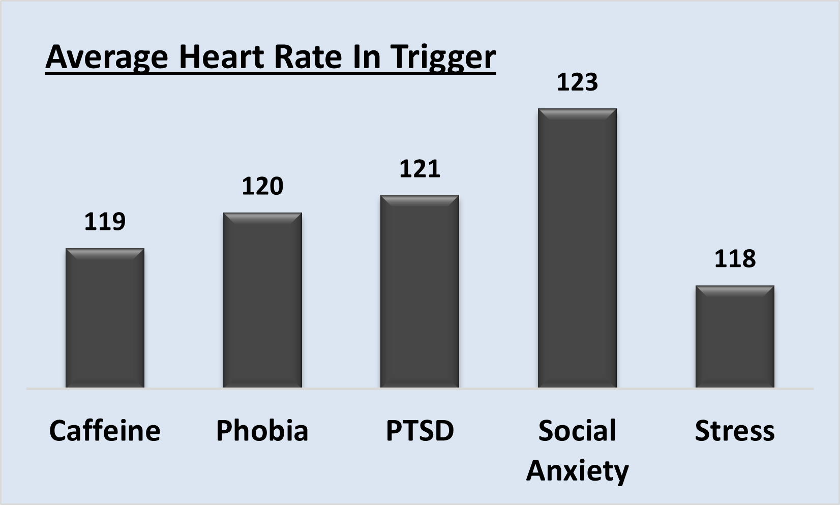

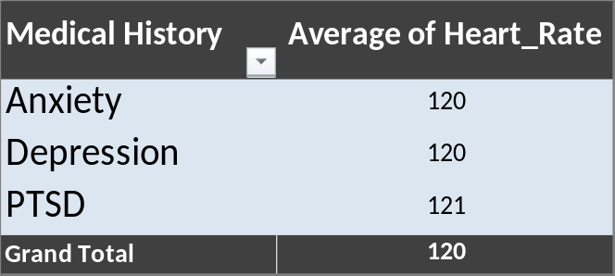
Average Heart Rates
Panic attack–induced heart rate is consistently above normal resting range (60–100 bpm), confirming physiological impact.
Senior citizens are most vulnerable to high heart rates, which could pose cardiac risks.
Social anxiety and PTSD are the most intense triggers, showing the strongest heart rate elevation.
Medical history of PTSD, anxiety, or depression maintains higher-than-average heart rates, suggesting chronic vulnerability.

Slide 6
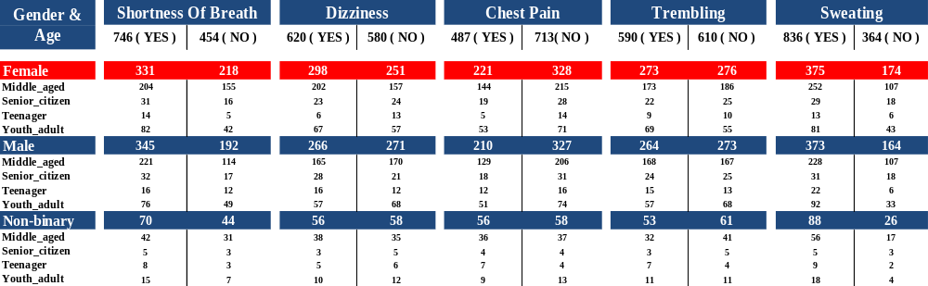
Symptoms Analysis
Sweating and shortness of breath are the most common symptoms of panic attacks.
Chest pain is the least reported.
Middle-aged individuals (both male and female) dominate the dataset for all symptoms.
Females report higher symptoms overall than males, while non-binary individuals show significant prevalence despite lower sample size.

Slide 7
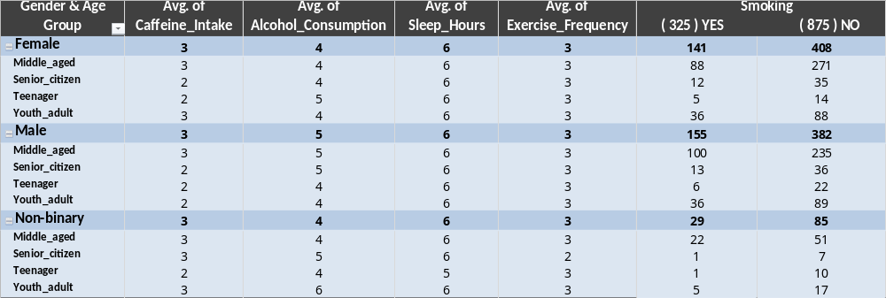
Lifestyle Factors
Caffeine and alcohol use are moderate but higher among middle-aged and youth adults, potentially acting as panic triggers.
Sleep deprivation ( avg. 6 Hours ) is a common issue across all groups, likely worsening anxiety and panic risk.
Low exercise frequency suggests poor stress management through physical activity.
Smoking is concentrated among middle-aged males and females, which may elevate cardiovascular risk during panic attacks.

Slide 8
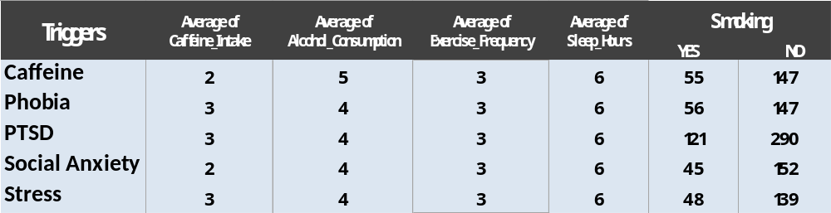
Relation To Triggers / Life Style
Caffeine Trigger :
Even small intake can be a significant trigger.
PTSD Trigger :
Strongly linked to higher smoking habits, moderate caffeine, and lower exercise.
Social Anxiety :
Lifestyle seems healthier (low caffeine, low alcohol, low smoking), yet still causes panic
attacks → suggests psychological rather than lifestyle-driven trigger.
Stress & Phobia :
Balanced lifestyle factors, but still trigger attacks → points to external/mental stressors more
than habits.

Slide 9
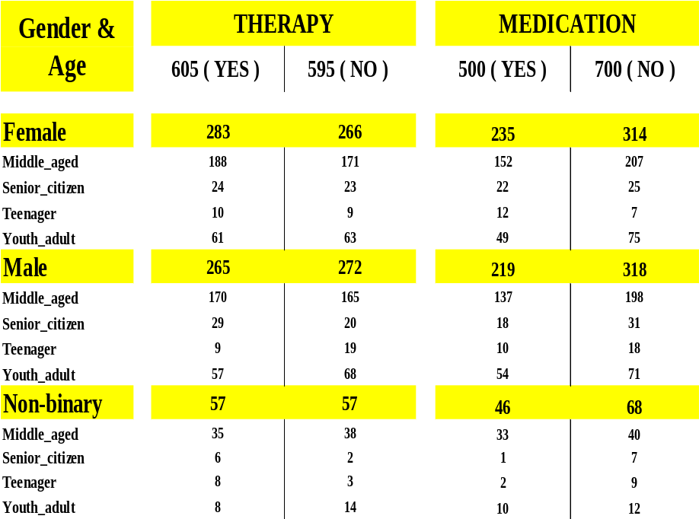
Treatment Choices across different genders and age groups
Female & Middle-Aged individuals have the highest therapy participation ( 188 YES ) ,and a significant medication uptake. ( 152 YES )
Overall, therapy has sightly higher total engagement ( 605 YES ) than medication. ( 500 YES )
Teenagers & Senior citizens are consistently the least likely to engage in either therapy or medication , regardless of gender.
These trends suggest that middle –aged individuals are the main demographic utilizing panic attack treatments ,while younger and older populations participate far less ,with therapy being marginally more popular than medication.

Slide 10
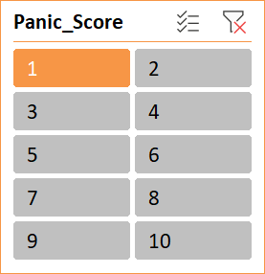
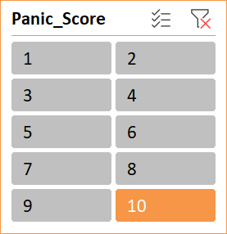
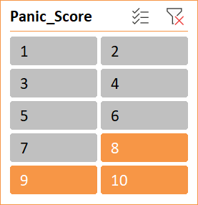

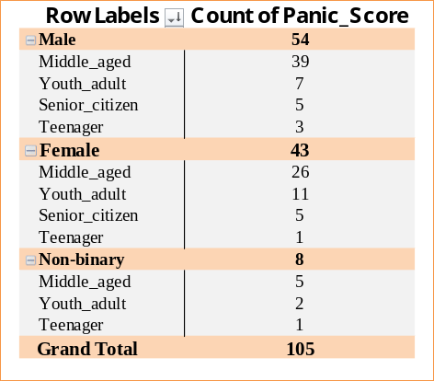
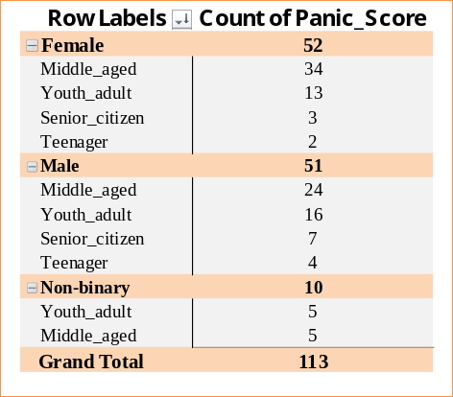
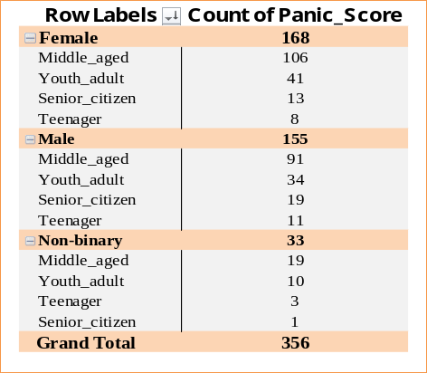
Panic Score Status
Higher panic scores seem concentrated among middle-aged & female participants , as evident from the larger counts in those groups.
Non-binary and senior citizen groups have the lowest representation or count of panic score.
Middle-aged individuals have the highest counts across most demographic splits ,especially among females. ( e.g.. 106 in the rightmost table )
Youth adults and Teenagers are consistently represented ,but with lower total compared to the middle-aged group.
Senior citizens appear with much lower counts rarely exceeding single digits.
Males & Females are the primary categories ,with Non-binary appearing only in the rightmost table with high panic score.
Female counts reach as high as 168 in the rightmost table, indicating possibly higher representation.

Slide 11
Conclusions
Triggers :
Caffeine and stress appear frequently as common panic attack triggers.
Individuals with PTSD, anxiety, or depression are at higher risk.
Symptoms :
Sweating, dizziness, chest pain, and trembling are common physiological signs.
Heart rate is consistently elevated during panic attacks (often >100 bpm).
Lifestyle Factors :
High caffeine and alcohol consumption correlate with more frequent or intense panic attacks.
Lack of exercise and poor sleep are linked with higher panic scores.
Therapy & Medication :
Many individuals undergoing therapy report slightly lower panic scores compared to those without therapy.
Medication users often still experience attacks, suggesting partial but not complete relief.
Demographics :
Panic attacks are prevalent across age groups, but middle-aged individuals dominate the dataset.
Gender distribution shows both males and females affected, with slightly higher representation in females

Slide 12
Recommendations
Lifestyle Management :
Reduce caffeine and alcohol intake to lower frequency/intensity of attacks.
Increase exercise (at least moderate activity 3–5 times a week) to improve resilience against triggers.
Maintain consistent sleep (7–9 hours) to regulate stress response.
Medical & Psychological Interventions :
Encourage therapy (CBT, mindfulness, exposure therapy) for patients with high panic scores.
Medication should be combined with lifestyle interventions, as drugs alone show limited effectiveness.
Trigger Awareness :
Patients should track and avoid personal triggers (caffeine, stress, trauma reminders).
Stress management techniques (breathing exercises, meditation, journaling) can reduce frequency.
Health Monitoring :
Regular monitoring of heart rate and panic frequency can help detect progress.
Screening for underlying conditions like depression, PTSD, or anxiety is crucial.
Awareness & Support :
Provide education to patients and families about panic attack symptoms to reduce stigma.
Support groups and peer counseling can improve coping strategies.

